Slide 1
Redux

Slide 2
Redux is a predictable state container for JS apps
It is not tied with react it can be used with Angular vue or even js
Stores the state for application means better state management
It is more of a architecture rather than technology
State of an application is the state represented by all the individual components of that app (This includes the data and Ui logic)

Slide 3
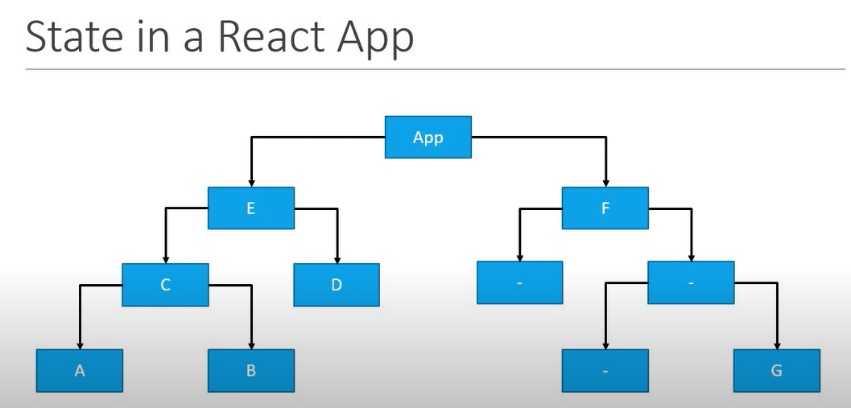
Why use Redux in React

Slide 4
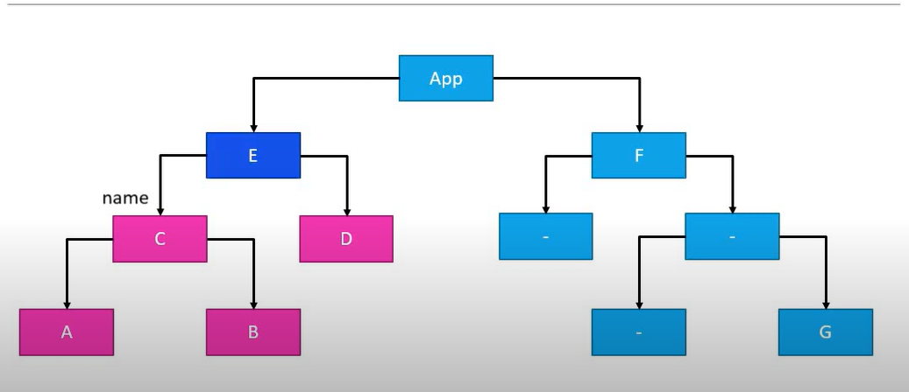

Slide 5
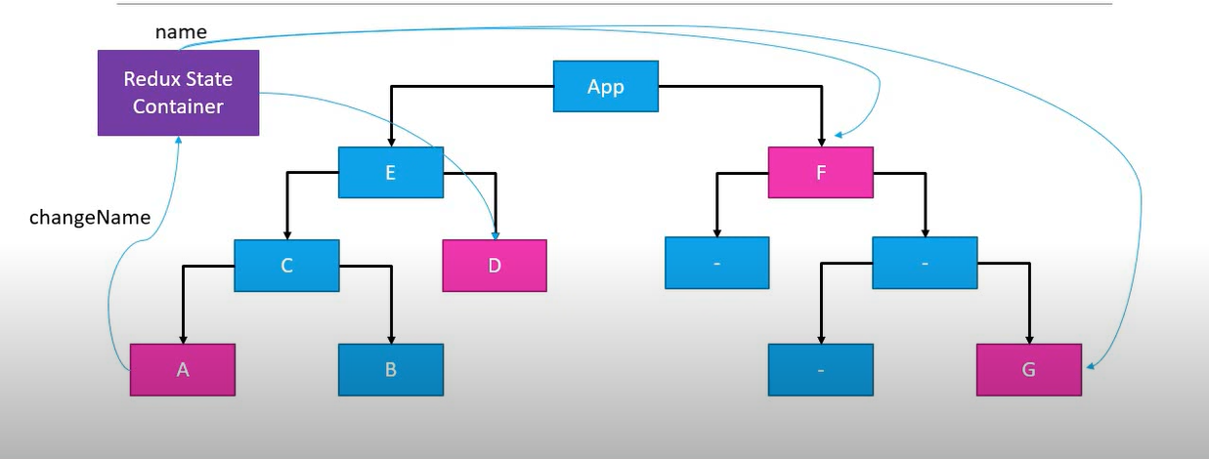

Slide 6
Redux principal
Store
Action
Reducer

Slide 7
Three Core concepts
Cake Shop
Entities
Shop – Store cakes on shelf
Shopkeeper At the front of store
Customer – At enterance

Slide 8
Cake Shop Scenario | Redux | Purpose
Shop | Store | Holds the state of application
Intention to BUY_CAKE | Action | Describes what happend
Shopkeeper | Reducer | Ties store and action together

